Slide 1
The Impact of Bank Shocks on Firm-Level Outcomes and Bank Risk-Taking
12th YOUNG ECONOMISTS’ SEMINAR
23rd DUBROVNIK ECONOMIC CONFERENCE
Dubrovnik, 4-6 June 2017
  Hans Degryse (KU Leuven, IWH Halle and CEPR)
  Olivier De Jonghe (Tilburg University and NBB)
  Sanja Jakovljević (CNB and KU Leuven)
  Klaas Mulier (Ghent University)
  Glenn Schepens (ECB)

Slide 2
Motivation
Finance is an important driver of economic growth.
  E.g., King and Levine (1993), Guiso, Sapienza and Zingales (2004), Beck, Demirgüç-Kunt, Laeven and Levine (2008), Rajan and Zingales (1998).
Banks are important providers of external finance to firms in general and SMEs in particular.
Bank-loan supply shocks may hamper the availability of credit and impact the real economy.
Main identification challenge: separating the firm-borrowing and the bank-lending channels.
  E.g., literature in the area of monetary policy; banking; corporate finance.

Slide 3
Motivation (2)
Research questions and main findings
1. Can the identification of bank supply shocks be adjusted to include the many
single-relationship firms? Does it matter?
    It can, and it does: the ranking of banks according to the magnitude of the shock varies, and the real impact of the recent financial crisis is better captured.
2. Are bank-loan supply shocks only relevant in crisis periods?
    The dispersion of bank supply shock estimates is also high in non-crisis periods.
3. Do bank-loan supply shocks impact firm performance and bank risk-taking?
    Negative bank supply shocks result in lower growth and investment of firms, and in risk-mitigating behavior by banks (and vice versa).

Slide 4
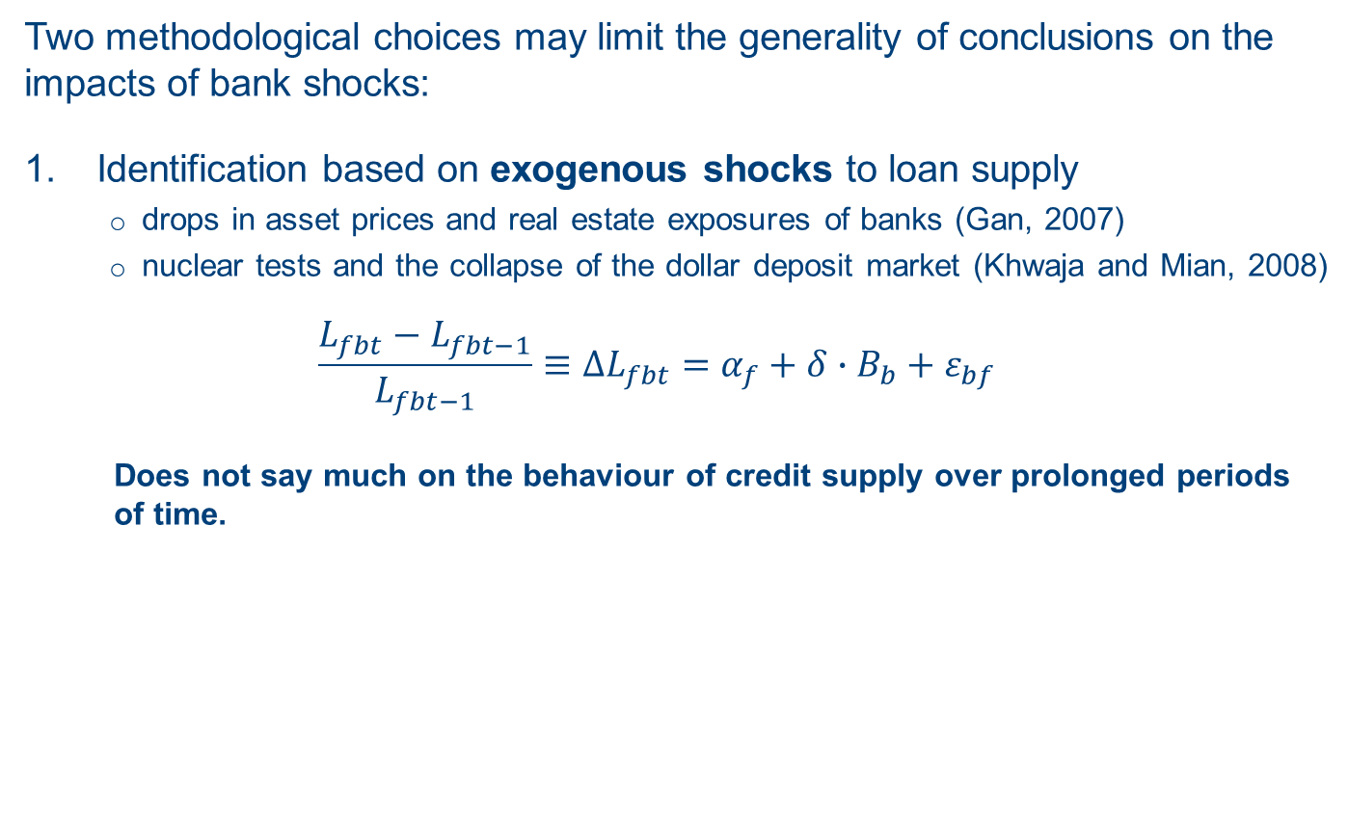
Identification of firm-borrowing and bank-lending channels
Two methodological choices may limit the generality of conclusions on the impacts of bank shocks:
Identification based on exogenous shocks to loan supply
    drops in asset prices and real estate exposures of banks (Gan, 2007)
    nuclear tests and the collapse of the dollar deposit market (Khwaja and Mian, 2008)
  $$\frac{L_{fbt}−L_{fbt−1}}{L_{fbt−1}}≡∆L_{fbt}=α_{f}+δ∙B_{b}+ε_{bf}$$
    Does not say much on the behaviour of credit supply over prolonged periods of time.

Slide 5
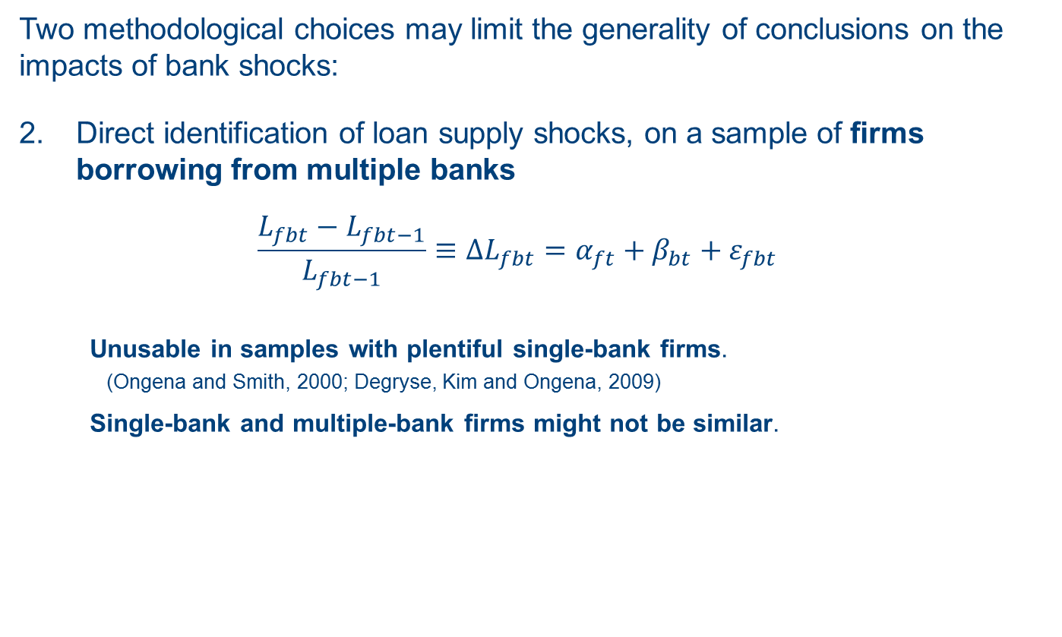
Identification of firm-borrowing and bank-lending channels (2)
Two methodological choices may limit the generality of conclusions on the impacts of bank shocks:
Direct identification of loan supply shocks, on a sample of firms borrowing from multiple banks
  $$\frac{L_{fbt}−L_{fbt−1}}{L_{fbt−1}}≡∆L_{fbt}=α_{ft}+β_{bt}+ε_{fbt}$$
    Unusable in samples with plentiful single-bank firms.
      (Ongena and Smith, 2000; Degryse, Kim and Ongena, 2009)
    Single-bank and multiple-bank firms might not be similar.

Slide 6
Our methodology
We address the methodological challenges by
Developing an indicator of bank-loan supply shocks which captures their cross-sectional variation, over an extended time period
Including firms borrowing from just one bank
Considering the weighting structure suggested by Amiti and Weinstein (2016)
    Adding-up constraints: a bank cannot lend more without at least one firm borrowing more and vice versa → Amiti and Weinstein (2016) suggest to use weighted least squares

Slide 7



Our methodology (2)
We provide an alternative demand control which encompasses the vast majority of firms.
  Firm-time fixed effects are replaced by industry-location-size-time fixed effects
  (2-digit NACE codes; 2-digit postal codes; deciles by total assets)
  →
$$∆L_{fbt}=α_{ft}+β_{bt}+ε_{fbt}$$
$$∆L_{fbt}=α_{ILSt}+β_{bt}+ε_{fbt}$$
$$α_{1t}=α_{2t}=…=α_{Ft}, (1..F)∈ILS$$

Slide 8
Our data
We use the following datasets of the NBB:
  Monthly bank-firm information on authorized credit to firms incorporated in Belgium (reporting threshold: 25,000 EUR)
  Annual accounts of Belgian firms
  Monthly bank balance sheet information
Time coverage: 2002m1 – 2012m3
Estimation sample: around 17 mil. bank-firm time observations

Slide 9
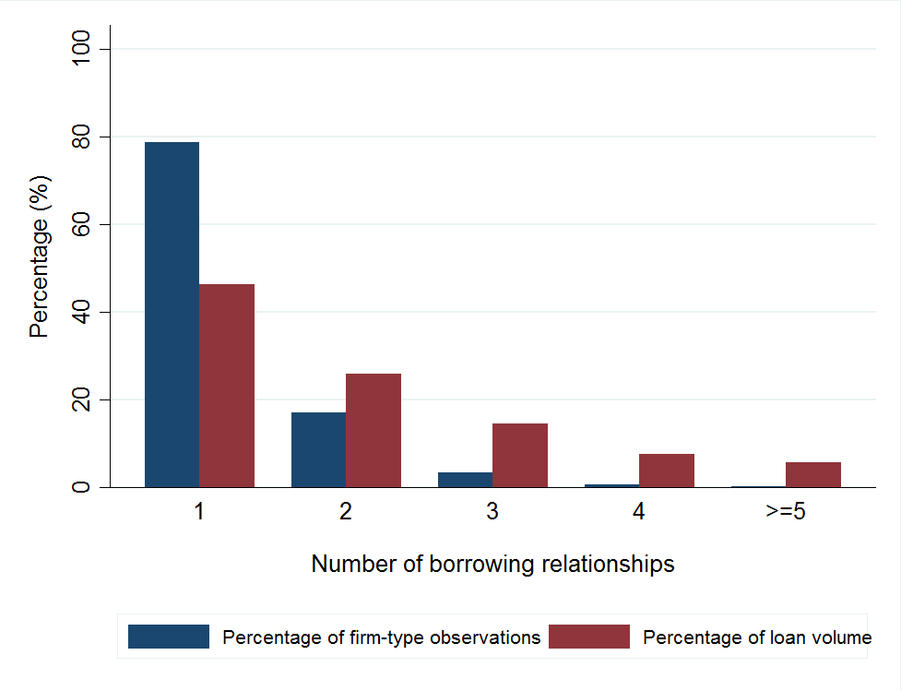
Our data (2)
How relevant are firms borrowing from just one bank?
Figure 1. The number of firm borrowing relationships and their share in total loan volume

Slide 10
Our data (3)
Are single-bank and multiple-bank firms similar?
Table 1. Characteristics of single-bank and multiple-bank firms
Multiple-bank firms are on average older, larger, have lower investment ratios and borrow larger credit amounts.

Slide 11
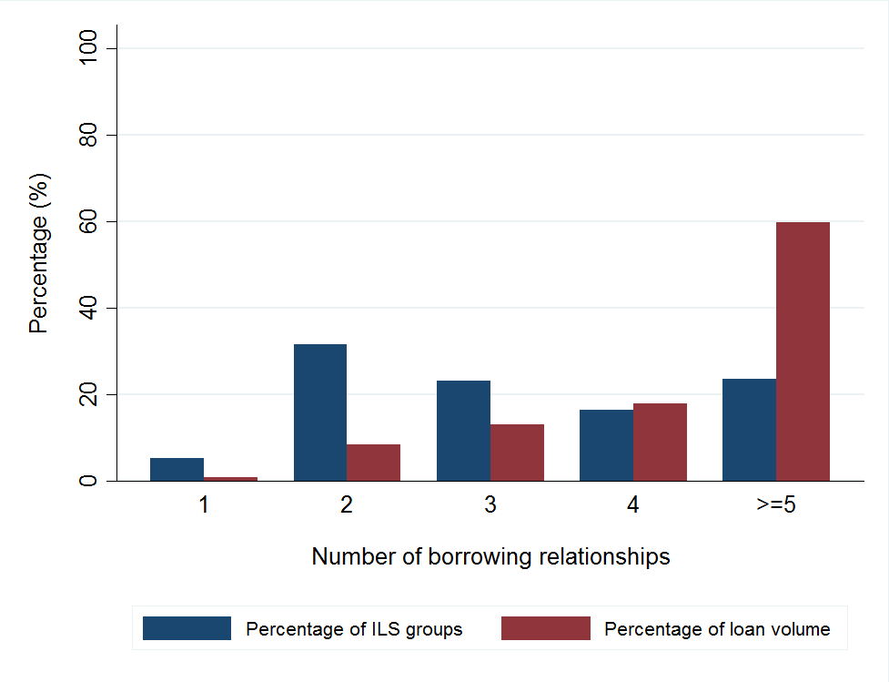
Our data (4)
What do we gain by considering the ILS grouping?
Figure 2. The number of ILS borrowing relationships and their share in total loan volume

Slide 12
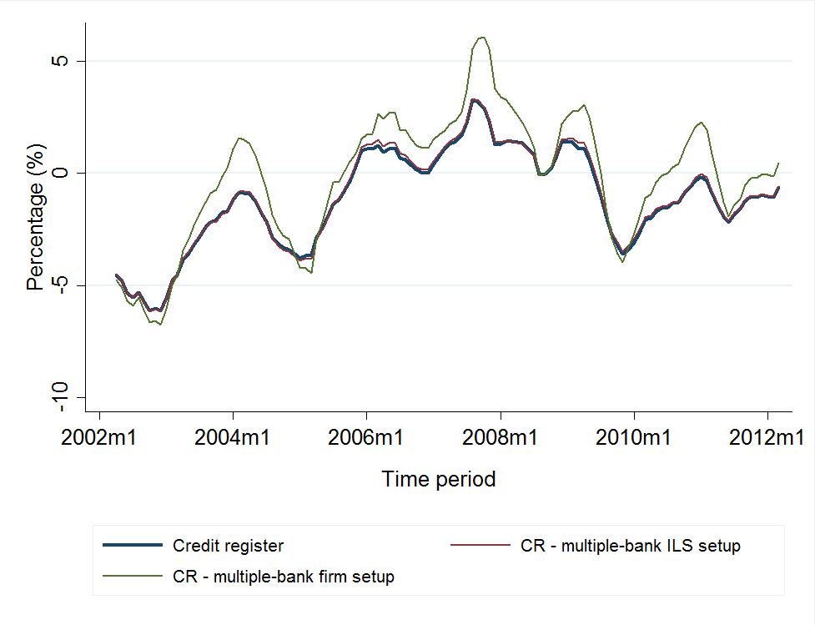
Our data (5)
What do we gain by considering the ILS grouping?
Figure 3. The average credit growth rate

Slide 13
Estimation and verification of bank-loan supply shocks: multiple-bank firm sample
Within the multiple-bank firm sample, we estimate the following set of equations:
  Demand controls: location,
  industry,
  age,
  current assets,
  risk (interest coverage ratio; debt; Altman Z),
  size.
$$∆L_{fbt}=α_{it}+β_{bt}^{i}+ε_{fbt}, i=∙,L,IL,ILA,ILC,ILR,ILS,F$$

Slide 14
Estimation and verification of bank-loan supply shocks: multiple-bank firm sample (2)
We then compare the bank shocks from various demand specifications with the “standard” bank shocks:
ILS provides the best fit;
The model performs equally well during crisis periods.
$${\hat{β}}_{bt}^{F}=δ∙{\hat{β}}_{bt}^{i}+μ_{t}+ε_{bt}, i=∙,L,IL,ILA,ILC,ILR,ILS,F$$
Table 2. Multiple-bank firm sample: comparison of credit demand controls

Slide 15
Estimation and verification of bank-loan supply shocks: multiple-bank ILS sample
As we extend the sample towards multiple-bank ILS groups, our bank shock estimates are departing from the “standard” bank shocks.
The ranking of banks based on the size of the shocks depends on the sample used.
We can meaningfully relate our bank shock estimates to:
  Tightening of lending standards (Bank Lending Survey)
  Growth in interbank liabilities
Table 3. Multiple-bank firm setup vs. multiple-bank ILS setup

Slide 16
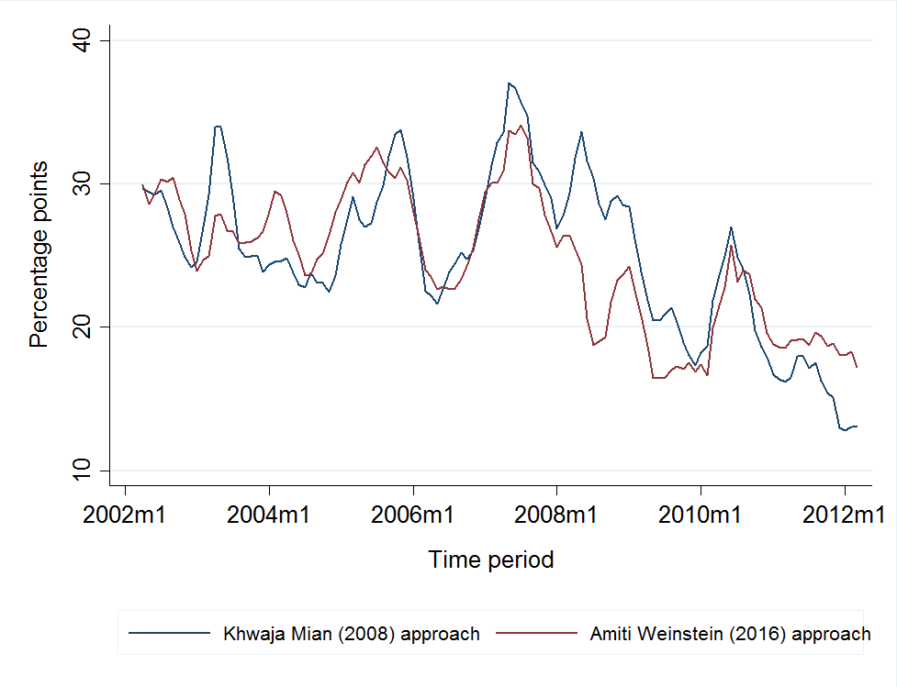
Variation of bank-loan supply shocks
Fluctuation of bank shocks might be high also in non-crisis periods!
Figure 4. Dispersion of estimated bank shocks (p75-p25)

Slide 17
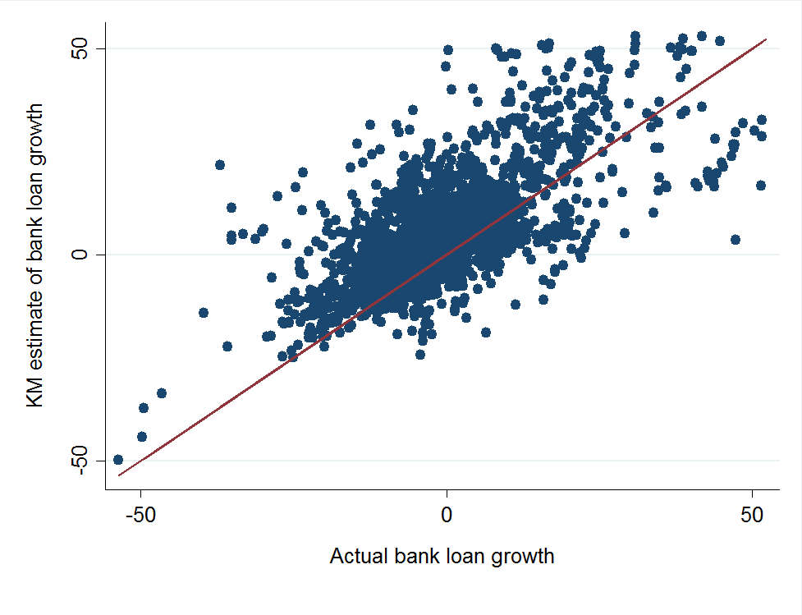
How (in)efficient are Khwaja and Mian (2008) estimates in our sample?
Not so much: suggestive of limited lending asymmetry.
Figure 5. The actual and predicted bank credit growth rates using KM(2008)

Slide 18
Application of bank-loan supply shocks
We analyse how bank-loan shocks relate to
Firm-level outcomes
    Growth (growth in total assets)
    Investment (growth in fixed assets)
    Employment (growth in number of FTE employees)
$$∆Y_{ft}=δ∙\sum_{b}{θ_{fbt−1}{\tilde{β}}_{bt−1}^{ILS(KM,AW)}}+μ_{t}+{γ_{f}+ε}_{ft}$$

Slide 19
Firm-level outcomes
Table 4. Bank credit supply estimates and firm-level outcomes
The weighting structure matters.
In the multiple-bank ILS sample, both methodologies work well in identifying shocks to growth and investment, albeit of somewhat differing economic magnitudes.

Slide 20
Firm-level outcomes (2)
Table 5. Bank credit supply estimates, firm growth and investment
When the crisis effects are considered in the multiple-bank ILS sample, our methodology captures them better than the “standard” one.
Same conclusion holds for smaller and more indebted firms.

Slide 21
Application of bank-loan supply shocks (2)
We analyse how bank-loan shocks relate to
Bank risk-taking (at the extensive margin)
    Portfolio-weighted average of firm-level Altman Z score
    Loan share
$${{\overline{Z}}_{bt}}^{ext}−{{\overline{Z}}_{bt−1}}^{int} =δ∙{\hat{β}}_{bt−1}^{ILS(KM, AW)}+μ_{t}+{ω_{b}+ε}_{bt}$$
$$\sum{L_{bt}^{ext}}/\sum{L_{bt−1}^{int}}=δ∙{\hat{β}}_{bt−1}^{ILS(KM, AW)}+μ_{t}+{ω_{b}+ε}_{bt}$$

Slide 22
Bank risk-taking
Table 6. Bank-loan supply estimates and bank risk-taking
New firms in the portfolio more risky and are taken on faster;
riskier firms also dropped from the portfolio, but more slowly:
risk-taking behaviour by banks with more positive supply shocks.

Slide 23
Conclusion
We develop a methodology to identify bank supply shocks in the presence of a multitude of single-borrowing firms.
Firms borrowing from lenders with a more negative bank-loan supply shock have lower growth, investment and (to some extent) employment rates, and vice versa.
Banks with more positive supply shocks take on more risk, and vice versa.

Slide 24
Thank you for your attention!

