Slide 1
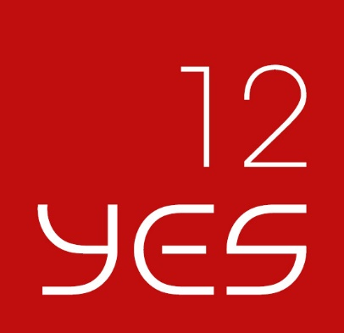
Comments on “Market Reactions to the Assessment of Other Systemically Important Institutions”
Evan Kraft
American University
Dubrovnik, 4 June 2017

Slide 2
What this paper does
Uses event-study methodology to look at the impact of announcements about OSII status on bank equity and CDS returns
Covers European Banking Authority announcement of 25 April 2016, EBA stress test, G-SIBs announcement and inclusion in Single Supervisory Mechanism announcement
Seeks to distinguish between three effects:
  Stigma effect—identified banks are seen as riskier
  Opacity effect—markets do not react because they learn nothing new
  Safe effect—identified banks are seen as safer

Slide 3
What the paper does especially well
Uses established event study based on methods seen in previous literature
Uses multiple significance tests to deal with concerns that abnormal returns are non-normally distributed
Is able to look at individual announcements as well as generalize about a set of announcements
Analyses bank-specific outcomes

Slide 4
What more could be done: how the announcements worked
More precise discussion of regulatory change and how they can be expected to affect market perceptions of valuation and default probability.
  Increased capital requirements are mentioned, but need some elaboration of ways in which supervision was tightened.
  Also, there is Systemic Risk Buffer. The capital requirements may be increased more under some circumstances.
P. 7 Refer to “a majority of academics” but to explain the results of the actual regulatory changes one needs to look at main features of the regulations themselves, not the various proposals of economists
More nuanced story
Note that “safe effect” may actually be implicit subsidy—Jamie Dimon comments on benefits of being a SIFI, Moeninghoff Ongena arguments

Slide 5
Results discussion
P. 19 say that markets did not react to national announcements, but many of the coefficients are significant in the CDS results in Table 6.

Slide 6
Extending the analysis to include Too-Big to Save and Institutions
Suggestion: add country’s fiscal position to bank-specific regressions as in Demirguc-Kunt and Huizinga 2014.
Can have separate effects for Europe-wide and national announcements
Also could add country governance scores to see the effects of institutions as in Fratzscher, Konig and Lambert

Slide 7
Robustness
Literature does not seem to have standards about the length of pre-event windows. Not clear if this was done. If not, try changing this as a robustness check.
Also, how about changing the event window itself as a robustness check?
If you did these and did not report them, tell the reader what you did without giving all the results. What you have done here is not clear enough.

Slide 8
Good work, on the way to a nice paper!

